Slide 1
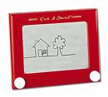
Lab 9 – Etch-a-Sketch
"Write a C language program that uses an analog to digital convertor (ADC) to sample two potentiometers and draw (etch) lines on the LCD. Use a low-pass filter to reduce the noise in the sampled values. Program one push button to clear the LCD and another to toggle the size of the drawing pen. Display the pen coordinates in the lower right corner of the display."
BYU CS/ECEn 124
Etch-a-Sketch Lab

Slide 2
Lab 9 – Etch-a-Sketch
Learn how to write C pre-processor functions.
Learn how to implement control and iterative statements in C.
Learn more about C looping structures.
Learn how strings are defined and used in C.
Learn how to configure and use an analog to digital converter (ADC).
Use the LCD in graphics mode to draw lines and shapes.
Learn about oversampling, low-pass filters, averaging, and thresholds to reduce "noise".
BYU CS/ECEn 124
Etch-a-Sketch Lab

Slide 3
Lab 9 – Etch-a-Sketch
// ************************************************************
// Lab 9 - Etch-a-Sketch
//
#include "msp430x22x4.h"
#include "eZ430X.h"
#include "lcd.h"
#include "adc.h"
#include "graphics.h"
#include "etch-a-sketch.h"
// ------------------------------------------------------------
// INITIALIZE SYSTEM CONSTANTS/VARIABLES
//
#define myCLOCK 1200000 // clock speed
#define WDT_CLK 32000 // 32 Khz WD clock (@1 Mhz)
#define WDT_CTL WDT_MDLY_32 // WDT SMCLK, ~32ms
#define WDT_CPS myCLOCK/WDT_CLK // WD clocks / second count
volatile int WDT_cps_cnt; // WD counts/second
extern const unsigned char byu_image[]; // BYU logo
#includes needed for Lab 9
BYU CS/ECEn 124
Etch-a-Sketch Lab

Slide 4
Lab 9 – Etch-a-Sketch
void main(void)
{
// init eZ430X development board
eZ430X_init(CALDCO_1MHZ); // init board
ADC_init(); // init ADC
lcd_init(); // init LCD
lcd_FRAM_init(); // clear lcd FRAM memory
// configure Watchdog
WDT_cps_cnt = WDT_CPS; // set WD 1 second counter
WDTCTL = WDT_CTL; // set WD to ~32ms
IE1 |= WDTIE; // enable WDT interrupt
__bis_SR_register(GIE); // enable interrupts
lcd_image(byu_image, 40, 11); // display BYU
lcd_backlight(ON); // turn on LCD backlight
lcd_display(LCD_2X_FONT|LCD_PROPORTIONAL);
lcd_cursor(4, 2); // set display coordinates
lcd_printf("Etch-a-Sketch");
lcd_display(~(LCD_2X_FONT|LCD_PROPORTIONAL));
Init board and perpherials
Initial splash screen
BYU CS/ECEn 124
Etch-a-Sketch Lab

Slide 5
Lab 9 – Etch-a-Sketch
Read potentiometers
Draw circle/coordinates
while (1)
{
int R_pot = ADC_read(RIGHT_POT); // read potentiometrs
int L_pot = ADC_read(LEFT_POT);
lcd_circle(R_pot>>2, 47, 20); // draw circle
lcd_cursor(60, 0); // output coordinates
lcd_printf("%d,%d ", L_pot, R_pot);
}
} // end main
//Watchdog Timer ISR
#pragma vector = WDT_VECTOR
__interrupt void WDT_ISR(void)
{
if (--WDT_cps_cnt == 0) // 1 second?
{
LED_GREEN_TOGGLE; // toggle green LED
WDT_cps_cnt = WDT_CPS; // reset counter
}
} // end WDT_ISR
Watchdog Interrupt Service Routine
BYU CS/ECEn 124
Etch-a-Sketch Lab

Slide 6
Lab 9 – Etch-a-Sketch
Your Etch-a-Sketch program is to be written in C.
You will need to determine the range of the potentiometer sampled values and scale them according to the pixel size of the LCD. (100 x 160)
You will need to develop an algorithm to "draw" a continuous line from point (x1,y1) to point (x2,y2). The line must not have any gaps (ie. when the pen moves, neither the x nor the y coordinate moves more than 1 pixel).
Reduce the analog potentiometer "noise" by using a low-pass filter, averaging, and/or thresholding the sampled potentiometer values.
When you have completed the above two items, proceed with writing your Etch-a-Sketch program.
BYU CS/ECEn 124
Etch-a-Sketch Lab

Slide 7
Lab 9 – Etch-a-Sketch
Your event loop should
  sample both potentiometers,
  filter the sampled values,
  watch for a change in pen coordinates,
  draw a line from the old to the new point
  update the LCD coordinates in the lower right corner.
In order to right justify the pen coordinates, you will need to determine the length of the coordinate string before displaying the values.
You will need to watch for any user activity and reset an inactivity counter. If the inactivity counter decrements to zero, turn off the LCD backlight. Turn the backlight back on with any activity.
Use the appropriate timer for backlight control.
BYU CS/ECEn 124
Etch-a-Sketch Lab

Slide 8
Lab 9 – Etch-a-Sketch
1 point Your system clock is set to 8 mHz. The LCD backlight turns on with any activity (ie., potentiometer moves or switch pressed). The backlight turns off after 5 seconds of no activity. The eZ430-RF2500 green LED toggles every second.
1 point The left potentiometer moves the LCD pen horizontally right (clock-wise) and left (counter clock-wise) while the right potentiometer moves the pen vertically up (clock-wise) and down (counter clock-wise).
2 points A continuous line is drawn (no gaps) in "real time" on the LCD from old to new pen coordinates as the potentiometers change.
2 points A low pass filter, averaging, and/or thresholding is used to reduce the "noise" found in the digital sampled values from the analog potentiometers.
1 point The pen coordinates are continuously displayed in the lower right corner of the LCD screen (right justified).
1 point Pressing switch #1 clears the LCD screen.
1 point Pressing switch #2 toggles the pen size between "single" and "double" pixel draw mode. (Be sure to "debounce" the switch inputs.)
1 point A C pre-processor function is used in your Etch-a-Sketch program (such as to scale the potentiometer values). The pre-processor function is defined in a header file (.h).
BYU CS/ECEn 124
Etch-a-Sketch Lab

Slide 9
Lab 9 – Etch-a-Sketch
Bonus/Deductions:
1 point Passed off with a TA at least one day early. (No timestamps please!)
1 point When turning off the LCD backlight because of no activity, use Timer A and pulse width modulation (PWM) to gradually decrease the LED's brightness.
1 point Another mode is added to switch #2 to select an erase pen drawing mode (single, double, erase). In erase mode, the "cursor" is displayed as a small circle.
2 points Pressing switch #3 saves the LCD image to another part of your FRAM, while pressing switch #4 clears and redraws the saved FRAM image on the LCD. (The LCD draw routines use FRAM locations 0-2079. There are 8192 8-bit memory locations available.)
-1 point For each school day late. (Timestamps may be used to verify completion time.)
BYU CS/ECEn 124
Etch-a-Sketch Lab

Slide 10
Analog-to-Digital Converter (ADC)
ADC converts analog signal to a digital number
Two 12-bit ADCs are used.
Read in 12-bit integer (0~1023)
Function to read potentiometers
ADC_read(RIGHT_POT); // RIGHT_POT=12
ADC_read(LEFT_POT); // LEFT_POT=13
LCD resolution is 160 x 100
  Convert 0~1023 to 0~159 for X
    multiply input by 160/1024 = 0.15625 (use float to preserve precision)
  Convert 0~1023 to 0~99 for Y
    multiply input by 100/1024 = 0.009765625 (use float to preserve precision)
BYU CS/ECEn 124
Etch-a-Sketch Lab

Slide 11
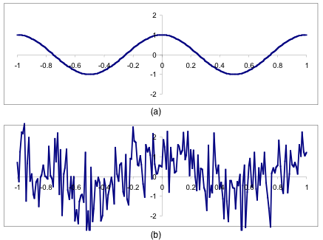
ADC Noise Reduction
An analog-to-digital converter converts continuous analog signals to discrete digital numbers.
Due to the finite resolution and the unavoidable imperfections in all types of an ADC, input values have distortions which we call "noise".
  manifests itself by the return values "dancing around"
  can result in bogus wave patterns
Reduce noise with
  A low-pass filter...
  Averaging...
  Thresholds...
BYU CS/ECEn 124
Etch-a-Sketch Lab

Slide 12
Sample Averaging
One common post-processing method used to condition an ADC signal is a simple digital low-pass filtering technique called windowing, rolling averaging, or simply, averaging.
Example:
#define N_SAMPLES 8
#define N_SHIFT 3
x = 0;
for (i = 0; i < N_SAMPLES; i++)
x += 1023 - ADC_read(LEFT_POT); // sum N samples
x += 1 << (N_SHIFT-1); // round result
x >>= N_SHIFT; // divide by N
BYU CS/ECEn 124
Etch-a-Sketch Lab

Slide 13
Signal Thresholding
Some very low frequency noise associated with a analog signal still pass thru a filtered output and manifest as values that "dance around".
Such an unwanted change is found in the least significant bits of the conversion process.
Example:
oldSample = ADC_read(INPUT_CHANNEL);
while (1)
{
newSample = ADC_read(INPUT_CHANNEL);
if (abs(newSample - oldSample) > THRESHOLD)
{
oldSample = newSample;
// process new sample
}
}
BYU CS/ECEn 124
Etch-a-Sketch Lab

Slide 14
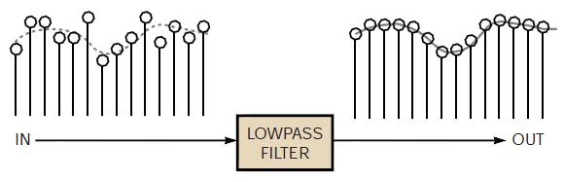
Weighted Low-pass Filter
Digital equivalent of an analog low-pass RC filter
unsigned int lowpass_filter(unsigned int input, unsigned int* delay)
{
// Update filter with current sample.
*delay = *delay - (*delay >> FILTER_SHIFT) + input;
// Scale output for unity gain.
return *delay >> FILTER_SHIFT;
}
BYU CS/ECEn 124
Etch-a-Sketch Lab

Slide 15
Weighted Low-pass Filter
Digital equivalent of an analog low-pass RC filter
delay_element += Input – (delay_element >> 4))
15 | 14 | 13 | 12 | 11 | 10 | 9 | 8 | 7 | 6 | 5 | 4 | 3 | 2 | 1 | 0
Output
BYU CS/ECEn 124
Etch-a-Sketch Lab

Slide 16
Weighted Low-pass Filter
#define FILTER_SHIFT 3 // Parameter K
// initialize low-pass filter
pot1_delay = lowpass_filter_init(1023 - ADC_sample(LEFT_POT));
pot2_delay = lowpass_filter_init(1023 - ADC_sample(RIGHT_POT));
...
// pass new potentiometer samples through low-pass filter
x = lowpass_filter(pot1, &pot1_delay);
y = lowpass_filter(pot2, &pot2_delay);
...
unsigned int lowpass_filter_init(unsigned int input)
{
return (input << FILTER_SHIFT) + (input >> FILTER_SHIFT);
}
unsigned int lowpass_filter(unsigned int input, unsigned int* delay)
{
*delay += input - (*delay >> FILTER_SHIFT); // update filter
return *delay >> FILTER_SHIFT; // scale output
}
BYU CS/ECEn 124
Etch-a-Sketch Lab

Slide 17
Draw on LCD Screen
Draw line only when either left (x) OR right (y) potentiometer (coordinate) is moved more than ? number of pixels.
New_x = ADC_read(LEFT_POT) x X_FACTOR;
New_y = ADC_read(RIGHT_POT) x Y_FACTOR;
if (abs(New_x – Old_x) > ? || abs(New_Y – Old_y) > ?) { // absolute difference
.......................... Set inactive counter, turn on LCD backlight, draw line
}
Old_x = New_x;
Old_y = New_y;
BYU CS/ECEn 124
Etch-a-Sketch Lab

Slide 18
Use WDT to turn the LCD off
Declare a global variable for the inactive counter.
Set inactive counter every time a line is drawn in the main program to a value that is equivalent to # of seconds needed.
Decrement inactive counter for every WDT interrupt.
Turn off LCD backlight, clear LCD, and display BYU.
BYU CS/ECEn 124
Etch-a-Sketch Lab

Slide 19
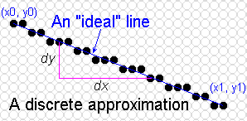
Line Draw
A continuous line is drawn if either the delta x or delta y is greater than 1 pixel.
One axis always increments (decrements) while the other axis only increments (decrements) as needed (based on calculation)
BYU CS/ECEn 124
Etch-a-Sketch Lab

Slide 20
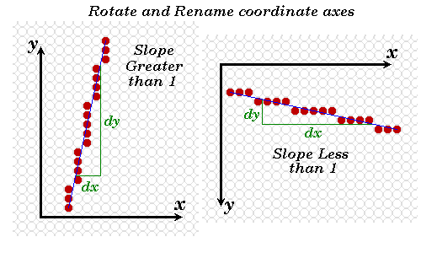
Line Draw
X increments when length > height
Y increments when height > length
BYU CS/ECEn 124
Etch-a-Sketch Lab

Slide 21

Otherwise .....
If y increments when length > height or
If x increments when height > length
BYU CS/ECEn 124
Etch-a-Sketch Lab

Slide 22
Create a DrawLine() Function
DrawLine(x0, y0, x1, y1) {
If (length > height) {
calculate slope
if (x1 > x0) {
for (i=x0; i<=x1; i++) lcd_point(1, ??);
} else {
for (i=x0; i>=x1; i--) lcd_point(1, ??);
}
} else {
calculate slope
if (y1 > y0) {
for (i=y0; i<=y1; i++) lcd_point(??, i);
} else {
for (i=y0; i>=y1; i--) lcd_point(??, i);
}
}
BYU CS/ECEn 124
Etch-a-Sketch Lab

Slide 23
Print Right Justified Text
Get the length of the character string
  "#include <string.h>”
  int strlen(const char *);
Clear the old print before printing new one
  lcd_blank(int column, int page, int width, int height);
Adjust print location according to the length
Make sure the last character printed is always printed at the same location (assume 150)
  lcd_cursor (150-StringLength*8, row);
BYU CS/ECEn 124
Etch-a-Sketch Lab

